Slide 1
DATA SCIENCE PROJECT
AUTOMOBILES DATASET

Slide 2
About the data set
This data set is from the Univerisity of California Irvine Machine Learning Repository The data was compiled by Jeffrey C. Schlimmer from the following sources:
1985 Model Import Car and Truck Specifications, 1985 Ward's Automotive Yearbook.
Personal Auto Manuals, Insurance Services Office, 160 Water Street, New York, NY 10038
Insurance Collision Report, Insurance Institute for Highway Safety, Watergate 600, Washington, DC 20037

Slide 3
This data set consists of three types of entities:
The specification of an auto in terms of various characteristics
Tts assigned insurance risk rating. This corresponds to the degree to which the auto is more risky than its price indicates. Cars are initially assigned a risk factor symbol associated with its price. Then, if it is more risky (or less), this symbol is adjusted by moving it up (or down) the scale. Actuaries call this process "symboling".
Its normalized losses in use as compared to other cars. This is the relative average loss payment per insured vehicle year. This value is normalized for all autos within a particular size classification (two-door small, station wagons, sports/speciality, etc...), and represents the average loss per car per year.

Slide 4
Objective
The aim here is to explore the data set and find basic relationships of different features with an automobile's price. We will be starting with some brief exploratory analysis involving summary statistics and graphical visualization. We will also be conducting a few tests of hypotheses on the study variable price. We also want to see if there is a way to predict the price of the automobiles given all the information we have. We will be comparing a few different regression models to find the best one.

Slide 5
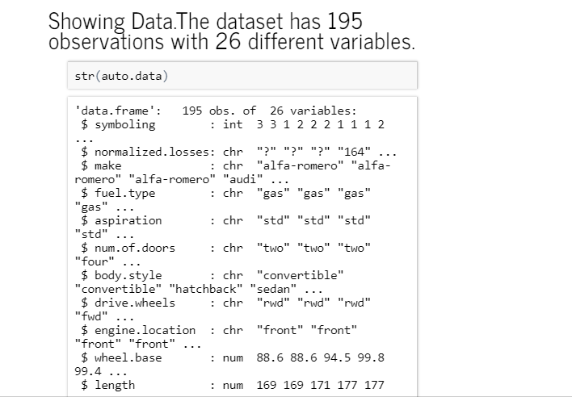
Loading the Dataset

Slide 6
Summary Statistics
We can learn a lot about a data set by looking at statistical summaries. The most common ones are Mean & Standard Deviation. The mean is a measure of central tendency and is defined as:
mean=μ=1nΣiximean=μ=1nΣixi
The standard deviation is a measure of the dispersion of a distribution defined as:
SD=σ=sqrt(11−nΣi(μ−xi)2sd=σ=sqrt(11−nΣi(μ−xi)2
Let's look at the summaries for the numeric attributes of the data set below:

Slide 7
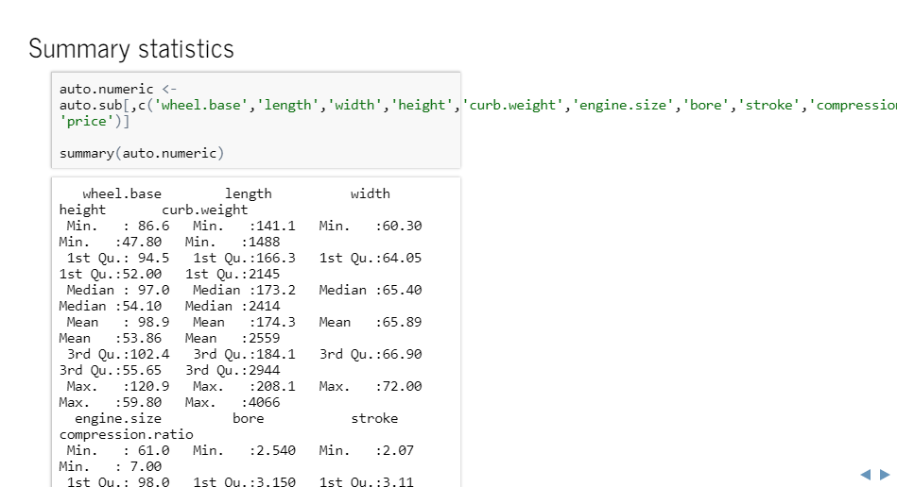
The upper interquartile ranges are different from the lower IQR, indicating the distributions are skewed. The mean and the median are also quite different. Again this is a sign of a skewed distribution.

Slide 8
Frequency tables
The summary techniques we have used so far are suitable only for numeric variables. Categorical variables have values which are typically unordered. Therefore, we need a method to summarize categorical variables based on counts. Frequency tabulation is one way of getting a better idea of the distribution of categorical variables.

Slide 9
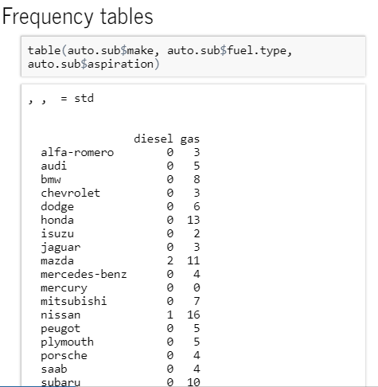
Notice that there are more Standard cars than there are Turbo & that most are Gasoline!

Slide 10
Covariance and correlation
Covariance is a measure of how much two random variables change together. Covariance is defined as follows:
cov(x,y)=E((x−μx)(y−μy))
If the greater values of one variable mainly correspond with the greater values of the other variable, and the same holds for the lesser values, i.e., the variables tend to show similar behavior, the covariance is positive. In the opposite case, when the greater values of one variable mainly correspond to the lesser values of the other, i.e., the variables tend to show opposite behavior, the covariance is negative. The sign of the covariance therefore shows the tendency in the linear relationship between the variables. The magnitude of the covariance is not easy to interpret because it is not normalized. The normalized version of the covariance is called the correlation coefficient.
Pearson's correlation coefficient is similar to covariance, but with normalization by the variance, and is defined as follows:
cor(x,y)=E((x−μx)(y−μy))σxσy

Slide 11
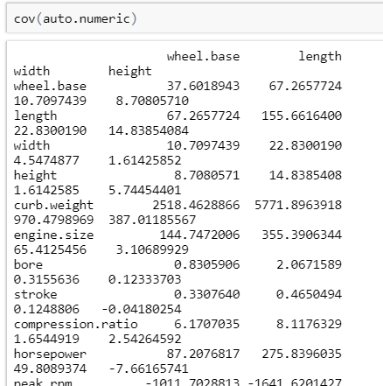
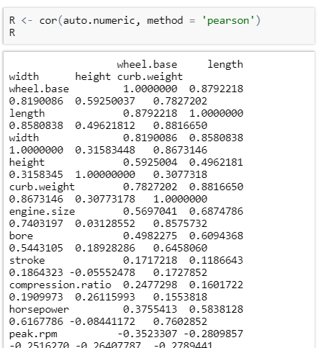
Covariance
Correlation

Slide 12
Covariance and correlation
The correlation matrix is a bit easier to understand, since the values are normalized. The diagonal values of the correlation matrix are all 1.0, as a result of the normalization. The magnitudes of the correlation values between the variables range between -1.0 and +1.0. A magnitude closer to +1.0 or -1.0 indicates a high correlation.
Some pairs of variables are weakly correlated, with small magnitudes. For example, wheel base and horsepower are weakly correlated, whereas engine size and curb weight are strongly correlated.

Slide 13
Data Visualization
Bar plots: Bar plots are used to display the counts or frequency of unique values of a categorical variable. The height of the bar represents the count for each unique category of the variable.
Histograms: Histograms are similar to bar plots, except that they are used for numeric variables
Box plots: Box plots, also known as box and whisker plots, were introduced by John Tukey in 1970. Box plots are another way to visualize the distribution of data values. In this respect, box plots are comparable to histograms, but are quite different in presentation.
Kernel Density Estimation Plots: Kernel density estimation uses a moving denisty kernel to average the density of the distribution. These are similar to Histogram, except that they show a smooth curve.
Scatter plots: A basic scatter plot shows the relationship between two variables. Points are ploted at the x-y coordinates of each value pair. Pair wise plots, also know as plot matrices, allow you to view multiple dimensions of a data set on one plot. A scatter plot is shown of each variable versus all other variables, arranged in an array
Line plots: Line plots are used to show the relationship between variables with ordered values.
Correlation plots: The correlation structure of a multivariate data set can provide some useful insight. However, it is hard to derive much insight by just looking at the matrix of numbers. A visualization can be useful in getting an overall impression of which variables have siginificant correlation.

Slide 14
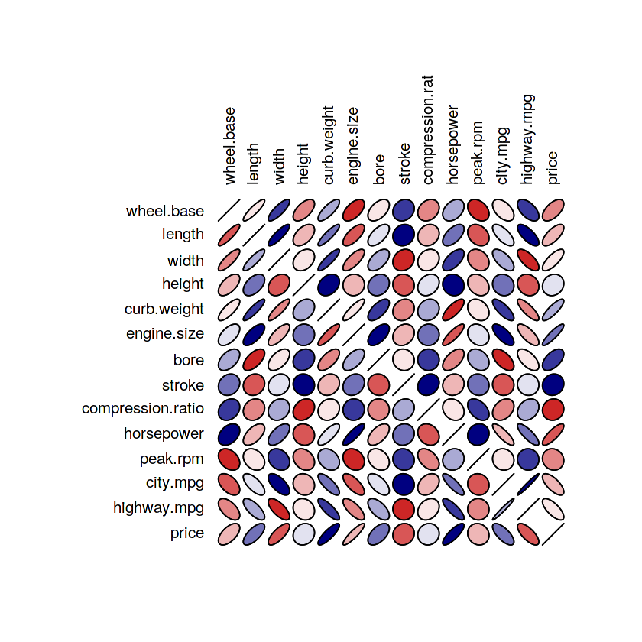
In the plot, the length of the minor axis is computed as 1−correlation. A correlation of 1 gives a line, with the minor axis set to 0. Correlation of zero results in a circle. The intensity of the color used on the plot indicates the magnitude of the correlation. Additionally, orientation of the ellipse is used to highlight the positive or negative correlation value. For positive correlation the ellipse tilts right, with the opposite being true for negative correlation.

Slide 15
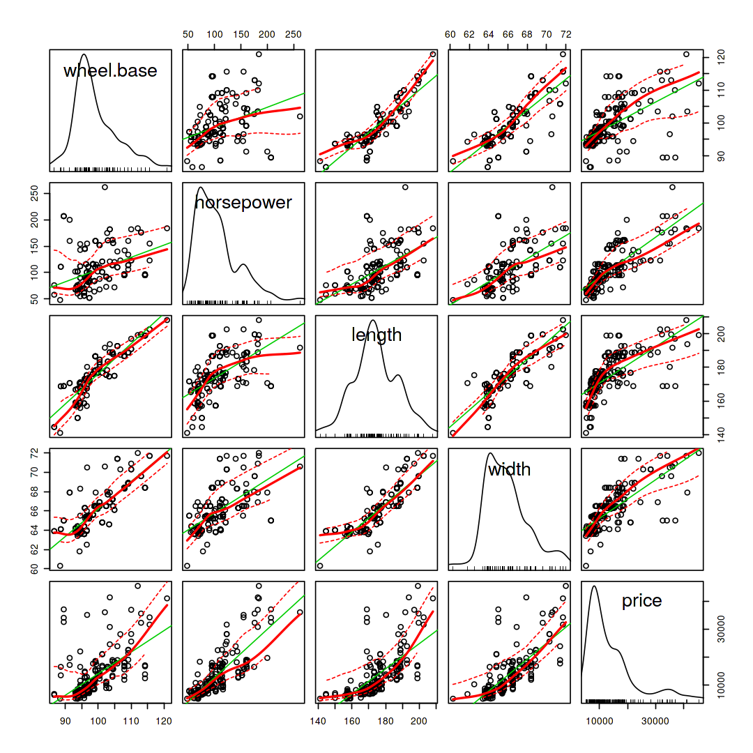
Relationship of automobile price with other numeric variables

Slide 16
Relationship of automobile price with other numeric variables
The pair wise scatter plot matrix below contains a number of elements, which are useful for understanding the relationships in the data sets.
There are Kernel Density Estimation plots for each variable along the diagonal of the matrix.
A pair of scatter plots for each variable pair is displayed. These two scatter plots show the axes in both possible orientations.
A linear regression line is shown in green on each scatter plot. This regression line gives an indiction of trend.
A nonlinear regression line with confidence intervals is shown in solid red. The nonlinear regression line can highlight more complex relationships in the data set. The confidence intervals, shown as dotted red lines, give some indication of the likely range of regression lines, given the uncertainty in the data.

Slide 17
Hypothesis Tests
A statistical hypothesis, sometimes called confirmatory data analysis, is a hypothesis that is testable on the basis of observing a process that is modeled via a set of random variables. A statistical hypothesis test is a method of statistical inference. Commonly, two statistical data sets are compared, or a data set obtained by sampling is compared against a synthetic data set from an idealized model. A hypothesis is proposed for the statistical relationship between the two data sets, and this is compared as an alternative to an idealized null hypothesis that proposes no relationship between two data sets. The comparison is deemed statistically significant if the relationship between the data sets would be an unlikely realization of the null hypothesis according to a threshold probability—the significance level. Hypothesis tests are used in determining what outcomes of a study would lead to a rejection of the null hypothesis for a pre-specified level of significance.

Slide 18
Hypothesis testing steps
Brief description of the steps involved:
We first state our population assumptions in the null hypothesis: H0H0.
We state a new hypothesis as an alternative to the null: HaHa.
The null + alternative should make up all possible outcomes and be mutually exclusive.
Decide on a significance level (probability cutoff): 0.90, 0.95, and 0.99 are common (problem specific).

Slide 19
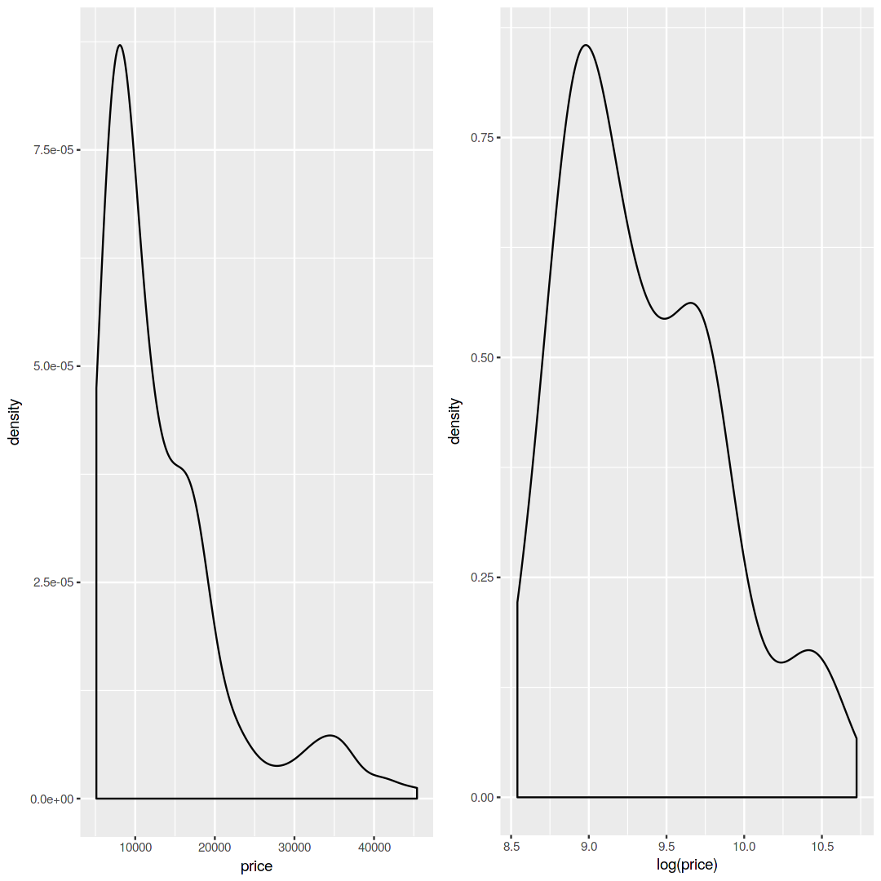
Examine these plots. Notice that the distribution is heavily skewed to the left or low side. This confirms our conclusions from looking at the summary statistics above. At first glance, these do not appear to have a normal bell shaped distribution. Let's examine this further

Slide 20
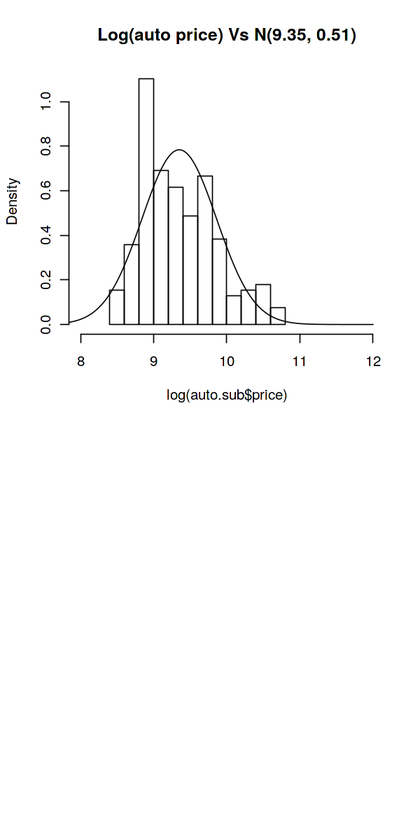
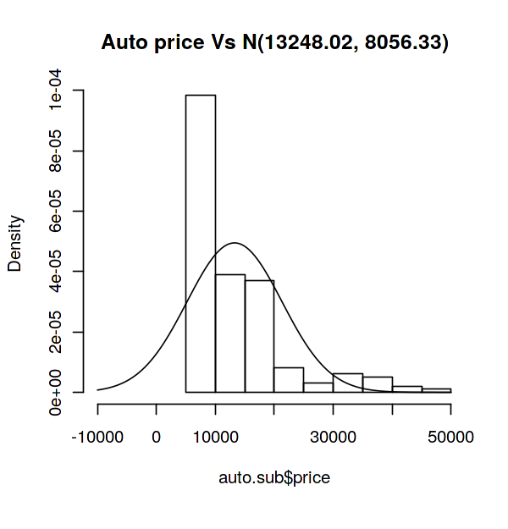
Here, we have plotted the histogram of price (figure above) & log(price) (figure below) againt respective normal distributions with mean and standard deviations of price & log(price) respectively. We see here that log(price) looks closer to having a normal distribution than just the price. Let's go a step further and check with Q-Q plots.

Slide 21
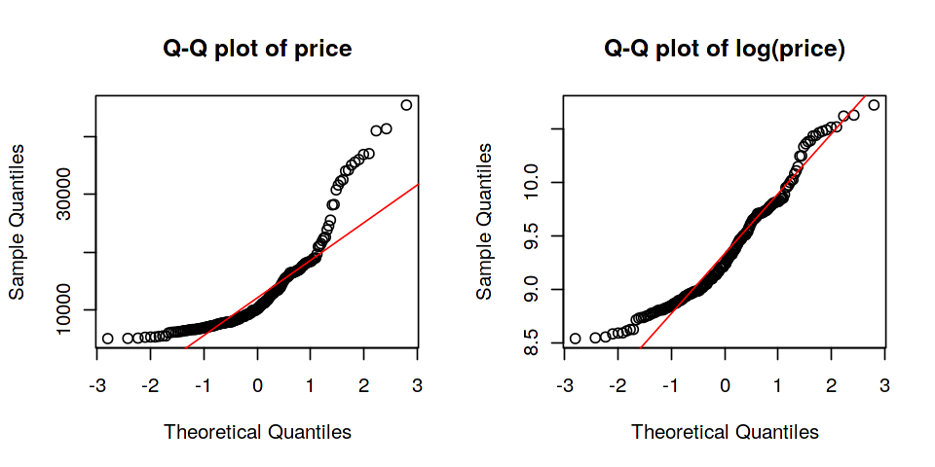
Q-Q plot
The qualtile-quantile (Q-Q) plot provides a handy visual means to inspect the Normality of a data set. If the sample is Normal the data points will fall in a straight line.

Slide 22
Further Analysis
Since the Q-Q plot on the left is clearly not a straight line, this (auto price) most likely does not follow a normal distribution.
Although the plot on the right appears less curvier than the Q-Q plot to the left, it is still hard to say if log(auto price) most likely follows a normal distribution or not. Now let's go ahead an run a test to see what we get.

Slide 23
The Kolmogorov-Smirnov test for distributions
The Kolmogorov-Smirnov test a general test of a distribution. The K-S statistic is just the maximum vertical distance between two CDFs. Since it is based on a simple deviation the K-S test can test departure from any hypothetical distribution, not just normal.
Here, we are testing if price ~ N(mean(price), sd(price))

Slide 24
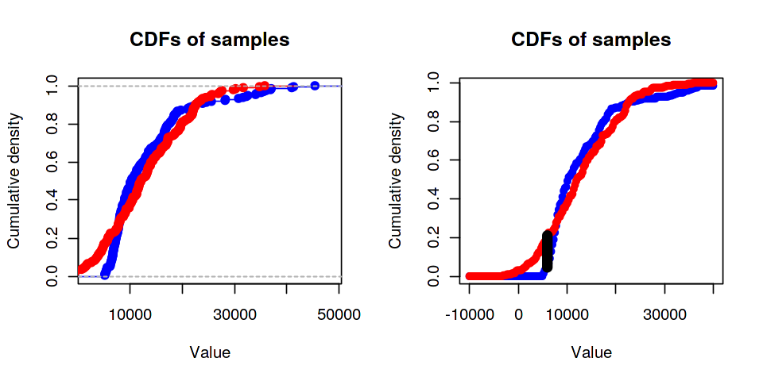

Slide 25
Since p-value (chance that the natural logarithm of price observations came from a N(9.35, 0.51) distribution) > 0.05 we cannot reject the null hypothesis. This means that there is a likelihood that these observations came from a normal population
The K-S test is rather general, as it can be applied to test any distribution. However, this means that the power of this test is limited. The power of a test is the probability of rejecting a null hypothesis when the alternative is true. There are ways to calculate the power of a test at any given level of significance and sample size, but we will not be delving into it here

Slide 26
Conclusion
We conducted brief exploratory analysis of how a car's price varies with other features or attributes of a car. We used summary statistical methods as well as visualization to get a general idea. We also conducted a few tests of hypotheses and found that:
log(price) follows normal distribution
We used t-test and bootstrap method to test the significance of price categorized by 1) fuel type, 2) aspiration & 3) body type and found that the bootstrap method is generally more accurate
We compared simple linear regression, Stepwise regression, Singular Value Decomposition & Elasticnet regression to find the best model for price and found that:

Slide 27
By- Sayam Khatri
Roll- 2017CSC1034
Thank you!
All the files are attached in the mail.
Html file is attached to view the r markdown file.
A zip folder is attached containg all the image samples and graphs plotted during anayalsis.

